Slide 1

CSCI E-25 Computer Vision
Attention and Transformers
Steve Elston
Copyright 2023, 2024, 2025, 2026, Stephen F Elston. All rights reserved.

Slide 2
Transformers for Computer Vision
Transformers are seen as an alternative to CNNs
Transformers are seen as a possible alternative or complement to CNNs
Transformers have revolutionized natural language processing (NLP)
But, CV is not the same as NLP
NLP is a 1-dimensional problem
NLP tokens less dense than pixels in an image
Global attention range is greater in images

Slide 3
Transformers for Computer Vision
Transformers are seen as an alternative to CNNs
Transformers are seen as a possible alternative or complement to CNNs
Transformers exhibit global attention
Transformers have limited inductive biases
Wider attention area than receptive field of CNN
No translation invariance
Transformers are rotationally invariant

Slide 4
Transformers for Computer Vision
Transformers are seen as an alternative to CNNs
But…………
Transformer architectures have only recently shown superior performance for limited tasks compared to CNNs
Transformers have higher computational complexity when compared to CNNs
Training transformer models requires massive amounts of data compared to CNNs

Slide 5
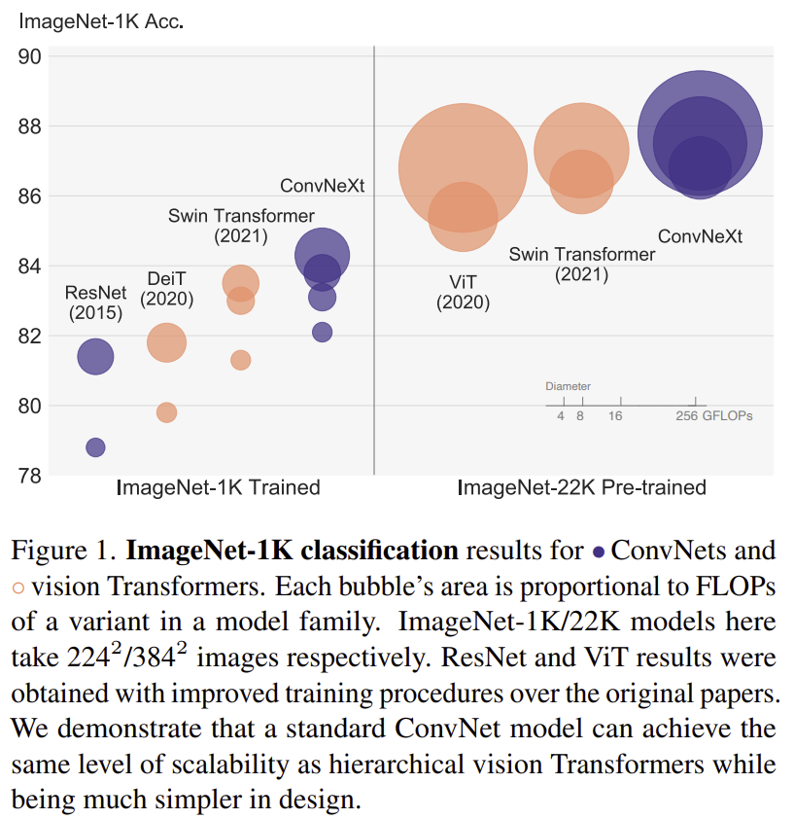
Transformers for Computer Vision
Transformers are seen as an alternative to CNNs
But…………
Generally, CNNs using advanced, efficient, architectures can provide equal or better performance
CNNs have lower latency in real-time solutions
From Liu, et. al, 2022

Slide 6

Convolutional Neural Networks
Transformer creates feature map in inference pipeline
Stem
Flatten feature map
Inference
Input Image
K output channel
feature map
Task specific head

Slide 7
Transformers for Computer Vision
Key components of transformer architecture
Multi-head attention
Recurrent architecture
Training on massive datasets
Self-supervised training
Prue transformer architectures use no convolutional layers
Hybrid architectures combine convolutional and transformer layers
Often effectively getting the best of both architectures

Slide 8
Attention for Computer Vision

Slide 9
Attention for CV
Images of real-world scenes have a significant spatial extent
Non-local attention adds non-local behavior to model
Attention map weights which pixels are most important in scene
Attention map contains pixel specific activations
Attention is computed using Tokens

Slide 10
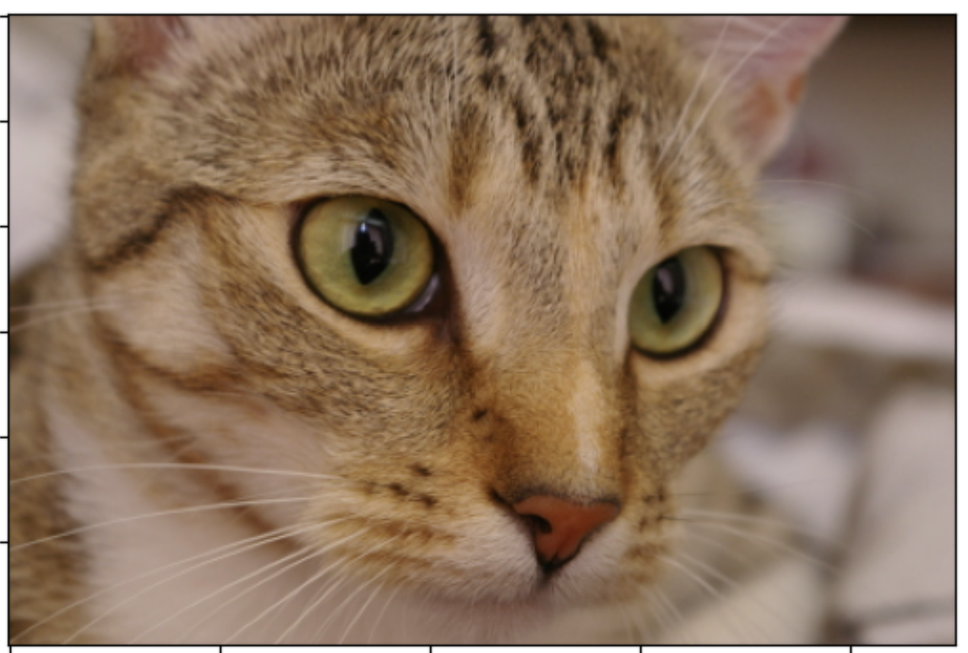
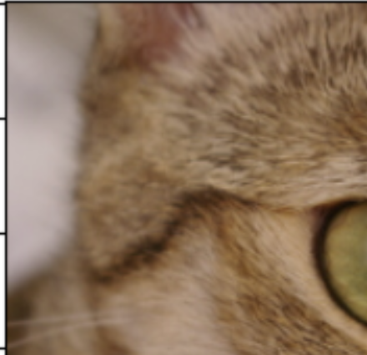
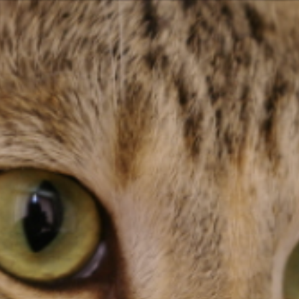
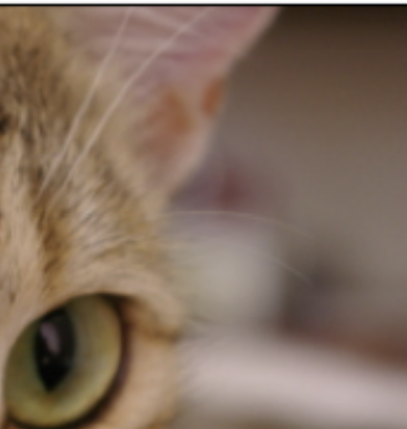
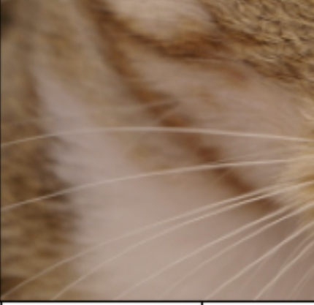
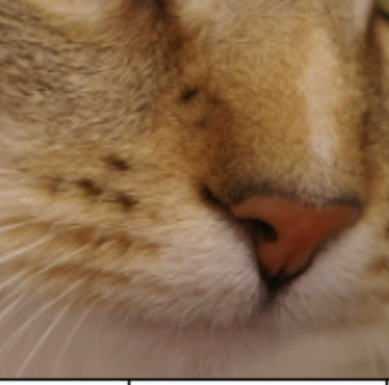
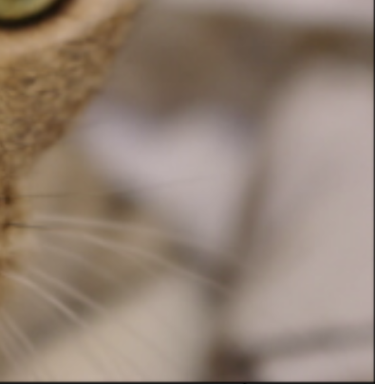
Attention for CV
Transformers operate on tokens
Tokens are a natural concept for NLP
We can tokenize an image by dividing into patches
Patches are flattened into token vectors with concatenated color channels
Tokenize Image

Slide 11
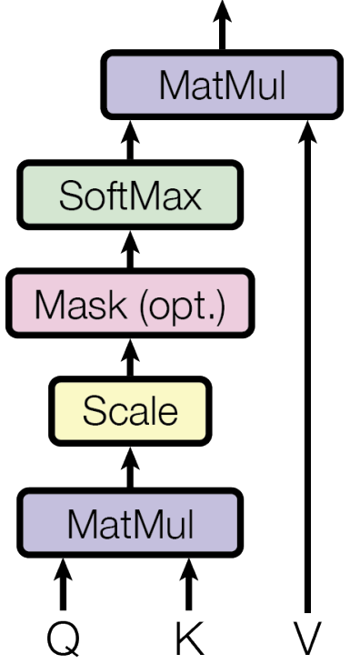
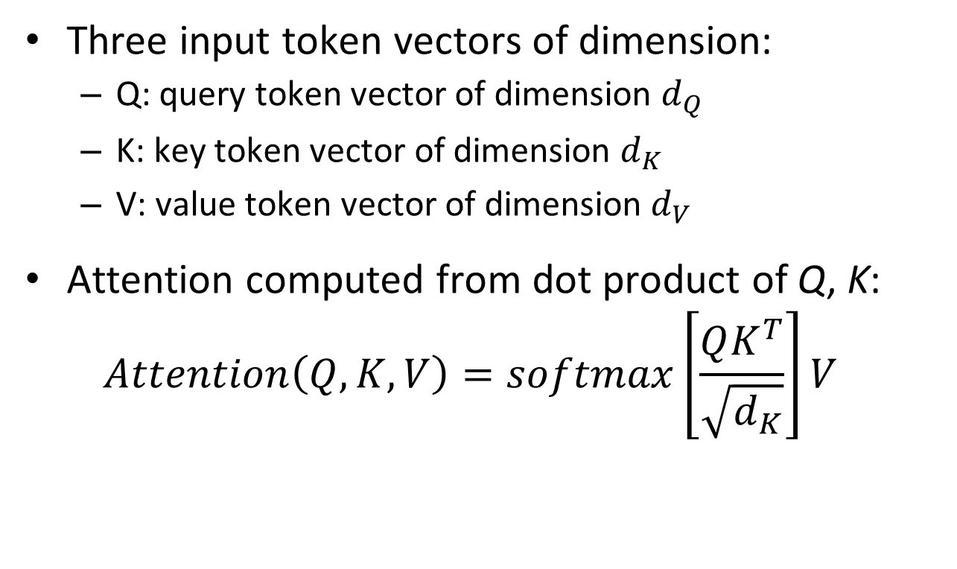
Attention for CV
Transformer architecture uses scaled dot product attention
Three input token vectors of dimension:
Q: query token vector of dimension $d_{Q}$
K: key token vector of dimension $d_{K}$
V: value token vector of dimension $d_{V}$
Attention computed from dot product of Q, K:
$$Attention\left(Q,K,V\right)=softmax\left[\frac{QK^{T}}{\sqrt{d_{K}}}\right]V$$
From Vaswani, et.al., 2016

Slide 12
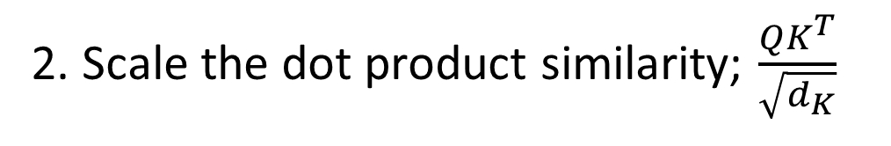
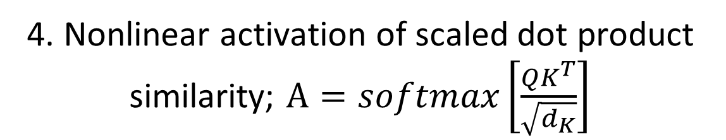
Attention for CV
Transformer architecture uses scaled dot product attention
5. Attention is applied to the values; $Attention\left(Q,K,V\right)=AV$
4. Nonlinear activation of scaled dot product similarity; $A=softmax\left[\frac{QK^{T}}{\sqrt{d_{K}}}\right]$
3. Mask prevents ‘backward’ information leakage in token sequence
2. Scale the dot product similarity; $\frac{QK^{T}}{\sqrt{d_{K}}}$
1. Dot product similarity between the query and key; $QK^{T}$
From Vaswani, et.al., 2016

Slide 13
Attention for CV
Transformer architecture uses scaled dot product attention
Attention arises from the similarity between the query and the key
What types of queries might we try?
A text string or prompt
Example, “Find animals in this image”
Another image token from the same or a different image
A similarity search over tokens (patches)

Slide 14
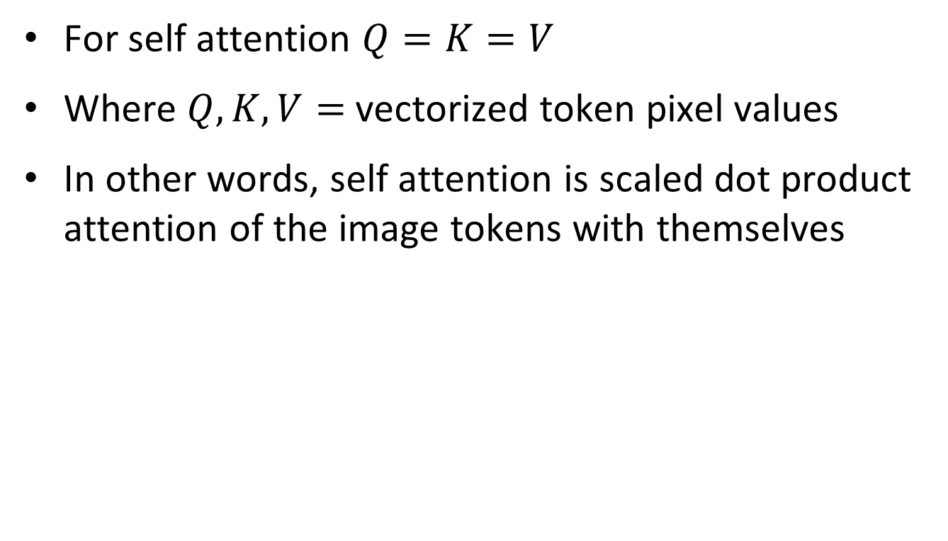
Attention for CV
Transformer architecture uses scaled dot-product self attention
For self attention $Q=K=V$
Where $Q, K, V=$ vectorized token pixel values
In other words, self attention is scaled dot product attention of the image tokens with themselves
From Vaswani, et.al., 2016

Slide 15
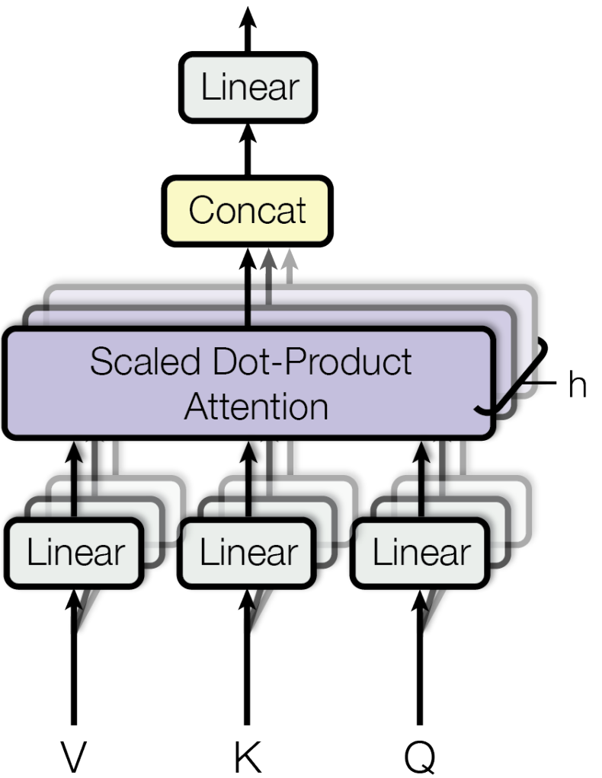
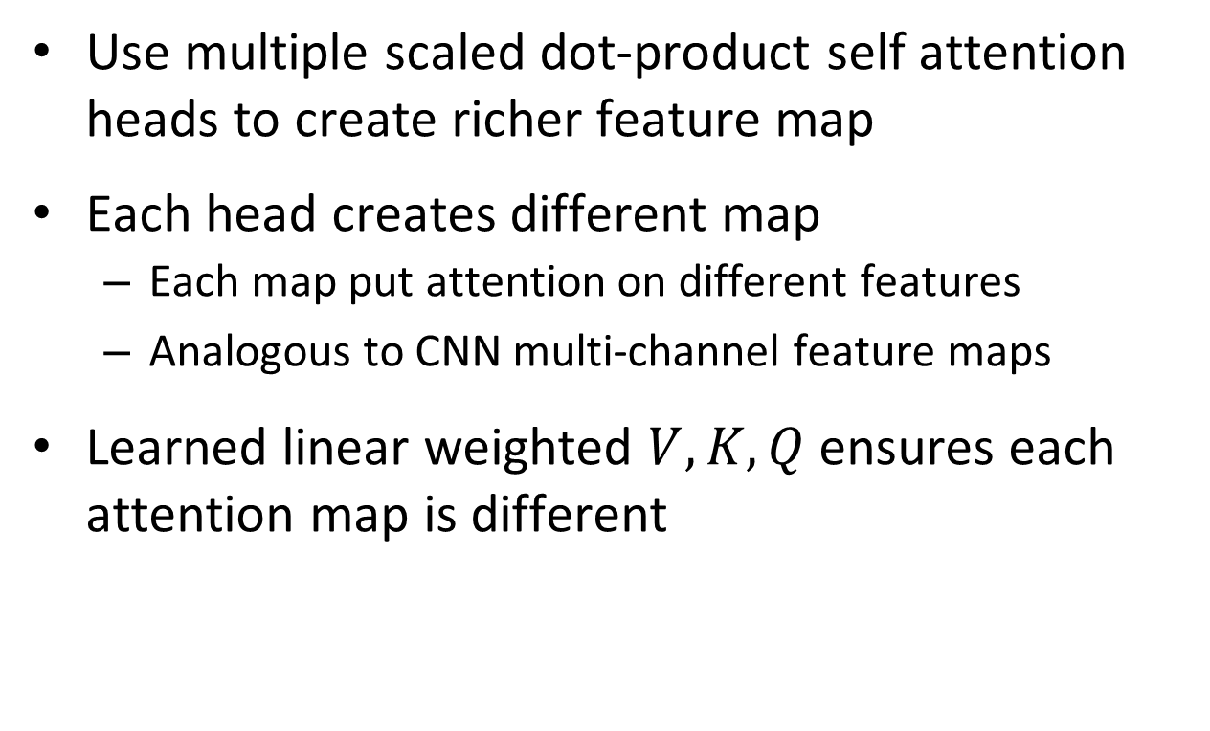
Attention for CV
Transformer architectures use multi-headed self attention
Use multiple scaled dot-product self attention heads to create richer feature map
Each head creates different map
Each map put attention on different features
Analogous to CNN multi-channel feature maps
Learned linear weighted $V,K,Q$ ensures each attention map is different
From Vaswani, et.al., 2016

Slide 16
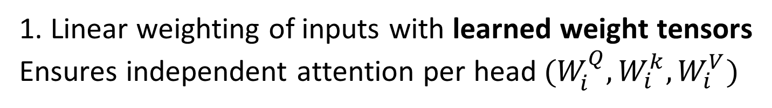
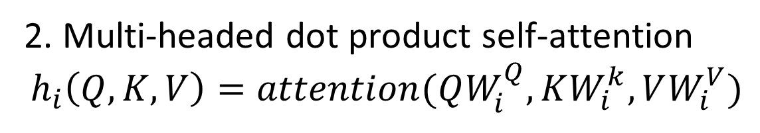
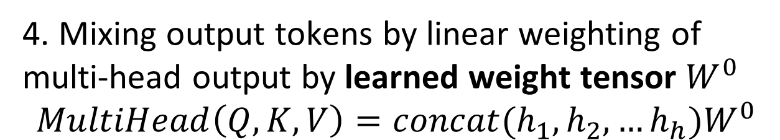
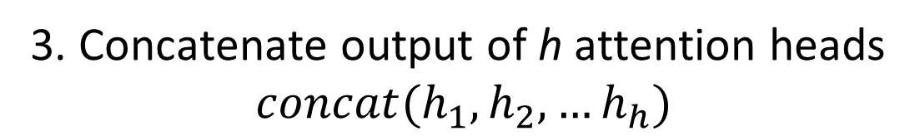
Attention for CV
Transformer architecture multi-headed self attention
4. Mixing output tokens by linear weighting of multi-head output by learned weight tensor $W^{0}$
$$MultiHead\left(Q,K,V\right)=concat(h_{1},h_{2},…h_{h})W^{0}$$
3. Concatenate output of h attention heads
$$concat(h_{1},h_{2},…h_{h})$$
2. Multi-headed dot product self-attention
$$h_{i}\left(Q,K,V\right)=attention(QW_{i}^{Q},KW_{i}^{k},VW_{i}^{V})$$
1. Linear weighting of inputs with learned weight tensors
Ensures independent attention per head$(W_{i}^{Q},W_{i}^{k},W_{i}^{V})$
From Vaswani, et.al., 2016

Slide 17
Transformer Encoder-Decoder Architecture

Slide 18
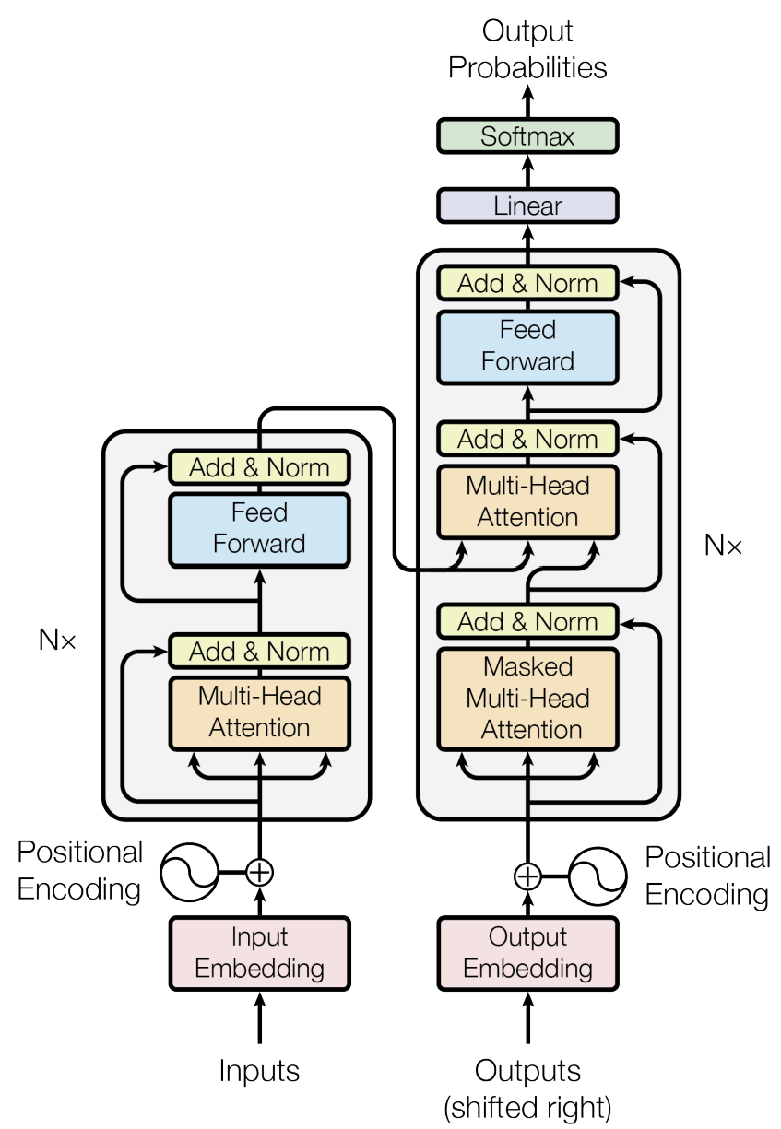
Transformer Encoder-Decoder Architecture
Architecture comprises multiple transformer blocks
Encoder-decoder architecture uses multiple transformer blocks
Is an encoder-decoder architecture
Each transformer layer is composed of three units
Encode inputs of new data values – image
Encode outputs from previous layers
Output decoder producing probabilities
From Vaswani, et.al., 2016

Slide 19
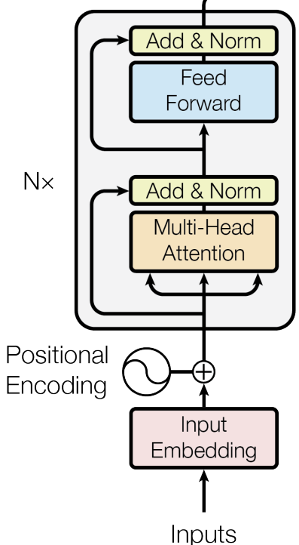
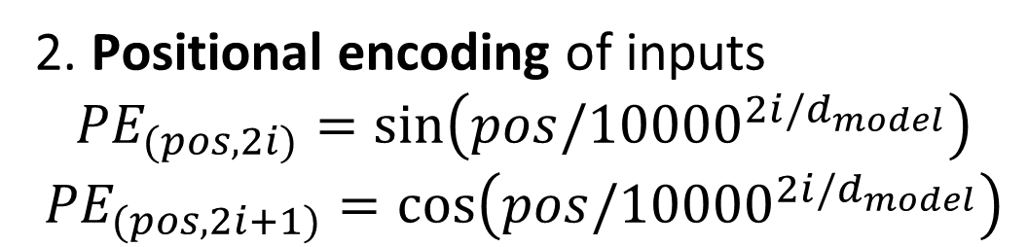
Transformer Encoder-Decoder Architecture
Dot product self attention head for input encoder
5. Residual loops
4. Fully connected layer with learned weight tensor
3. Multi-head dot product self-attention
2. Positional encoding of inputs
$${PE}_{(pos,2i)}=\sin\left(pos/{10000}^{2i/d_{model}}\right)$$
$${PE}_{(pos,2i+1)}=cos⁡\left(pos/{10000}^{2i/d_{model}}\right)$$
1. Linear token embedding with learned weight tensor
From Vaswani, et.al., 2016

Slide 20
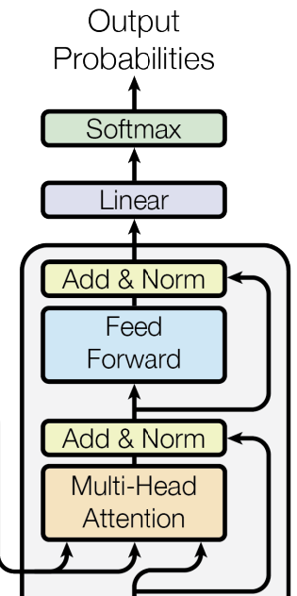
Transformer Encoder-Decoder Architecture
Dot product multi-headed self attention output decoder
6. Softmax squashes output to probabilities
5. Linear weighting of multi-head output by learned weight tensor
4. Residual loop
3. Fully connected network with learned weight tensor
2. Residual loop of V from previous layer encoder
1. Multi-head cross-attention with K, Q from input encoder and V from previous layer encoder
K, Q
V
From Vaswani, et.al., 2016

Slide 21
Vision Transformer (ViT) Architecture

Slide 22
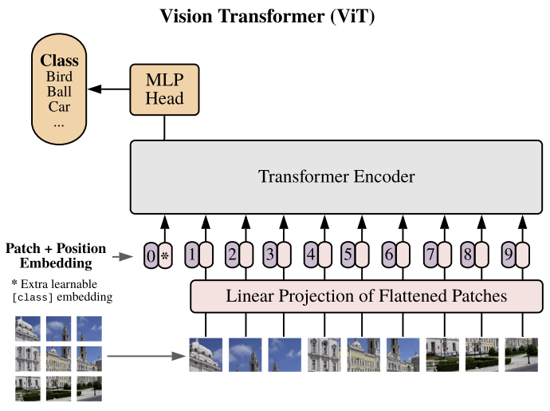
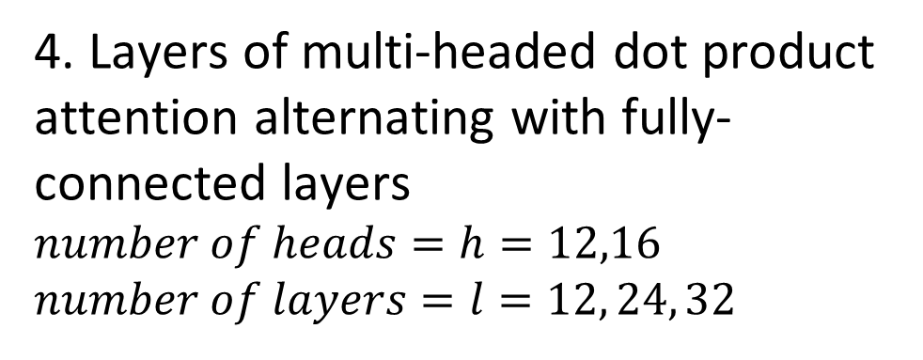
Vision Transformer (ViT) Architecture
We now have all the components to put the ViT model together
5. Fully connected multi-layer classifier uses attention feature map
4. Layers of multi-headed dot product attention alternating with fully-connected layers
$number of heads=h=12,16$
$number of layers=l=12, 24, 32$
3. Sequence of linear position encodings
1. Partition input image into patches
From Dosoviskiy, et.al., 2021
2. Sequence of patch tokens

Slide 23
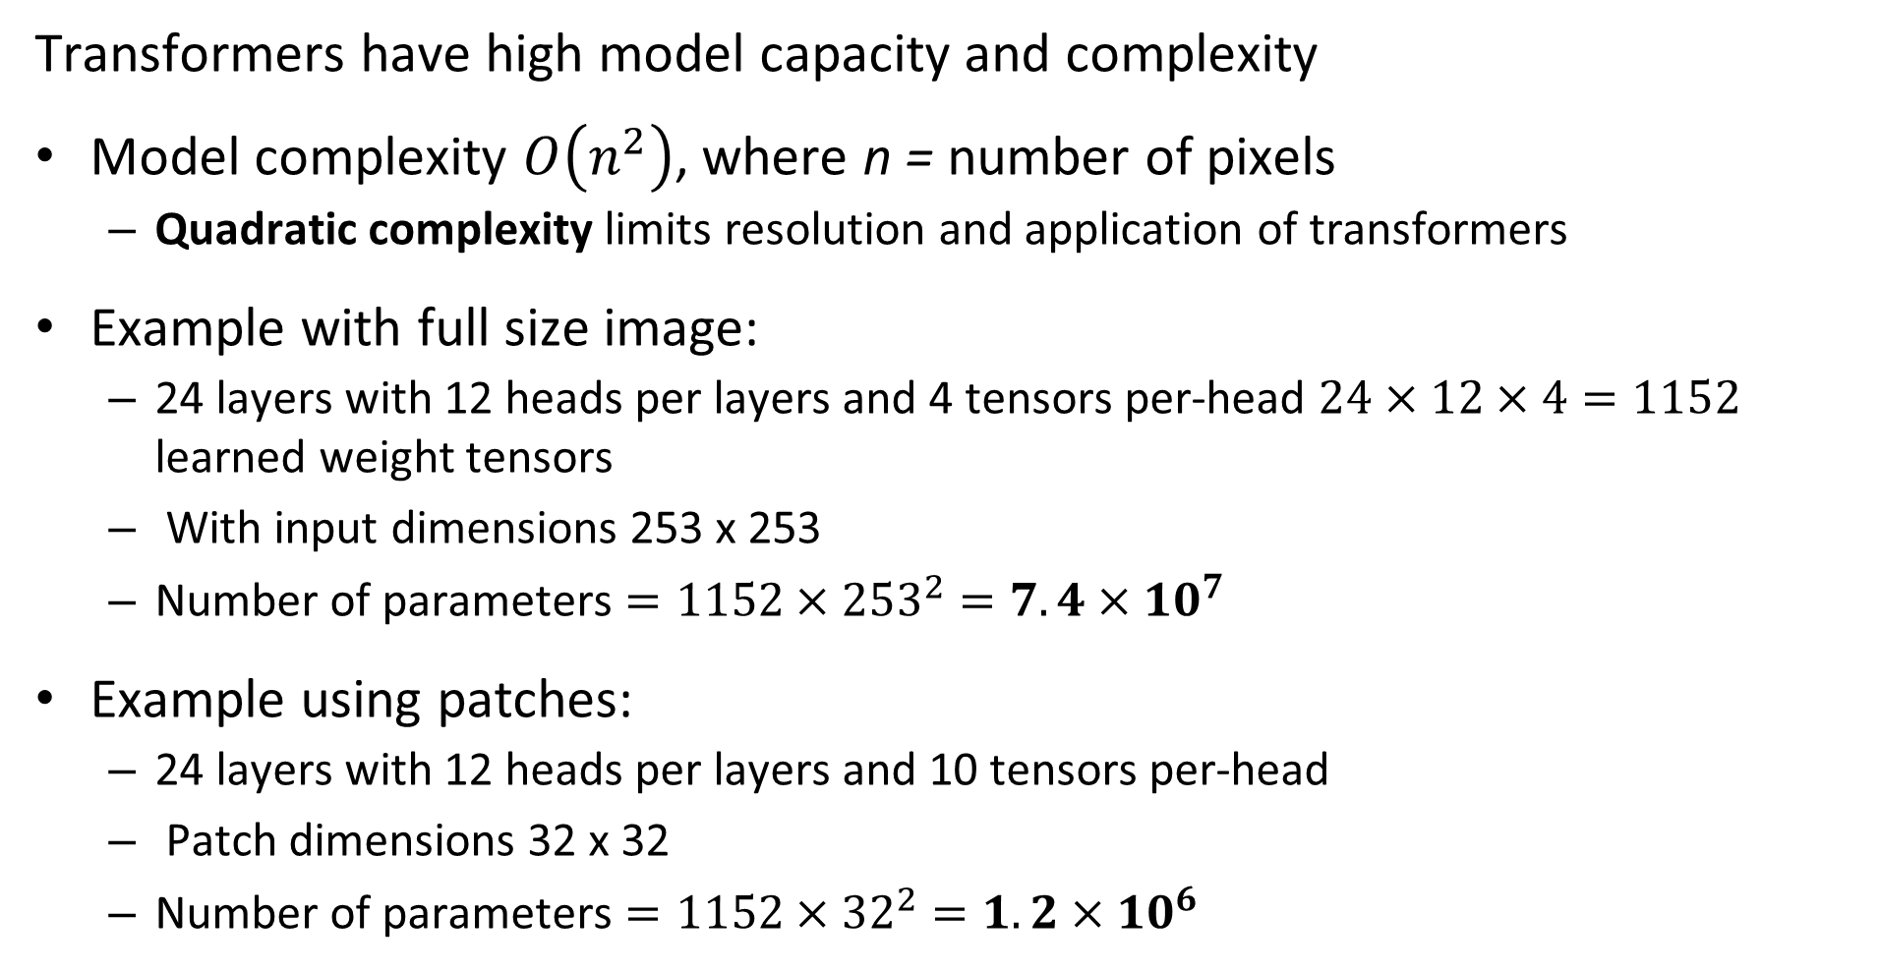
Why Use Patches?
Transformers have high model capacity and complexity
Model complexity $O\left(n^{2}\right)$, where n = number of pixels
Quadratic complexity limits resolution and application of transformers
Example with full size image:
24 layers with 12 heads per layers and 4 tensors per-head $24×12×4=1152$ learned weight tensors
With input dimensions 253 x 253
Number of parameters $=1152×{253}^{2}=7.4×{10}^{7}$
Example using patches:
24 layers with 12 heads per layers and 10 tensors per-head
Patch dimensions 32 x 32
Number of parameters $=1152×{32}^{2}=1.2×{10}^{6}$

Slide 24
Why Do We Need Positional Encoding?
Transformer models are permutation invariant with respect to the tokens
Tokens for a transformer model can be created with any spatial relationship
Tokens created from these patches are the same since transformer is permutation invariant

Slide 25
Why Do We Need Positional Encoding?
Transformer models are permutation invariant with respect to the tokens
Image patch and token ordering should preserve spatial relationships
CNNs are not permutation invariant and naturally preserve spatial relationships
We apply positional encoding to tokens
Position in color channel, x and y dimensions
Append positional encoding vector to image patch token

Slide 26
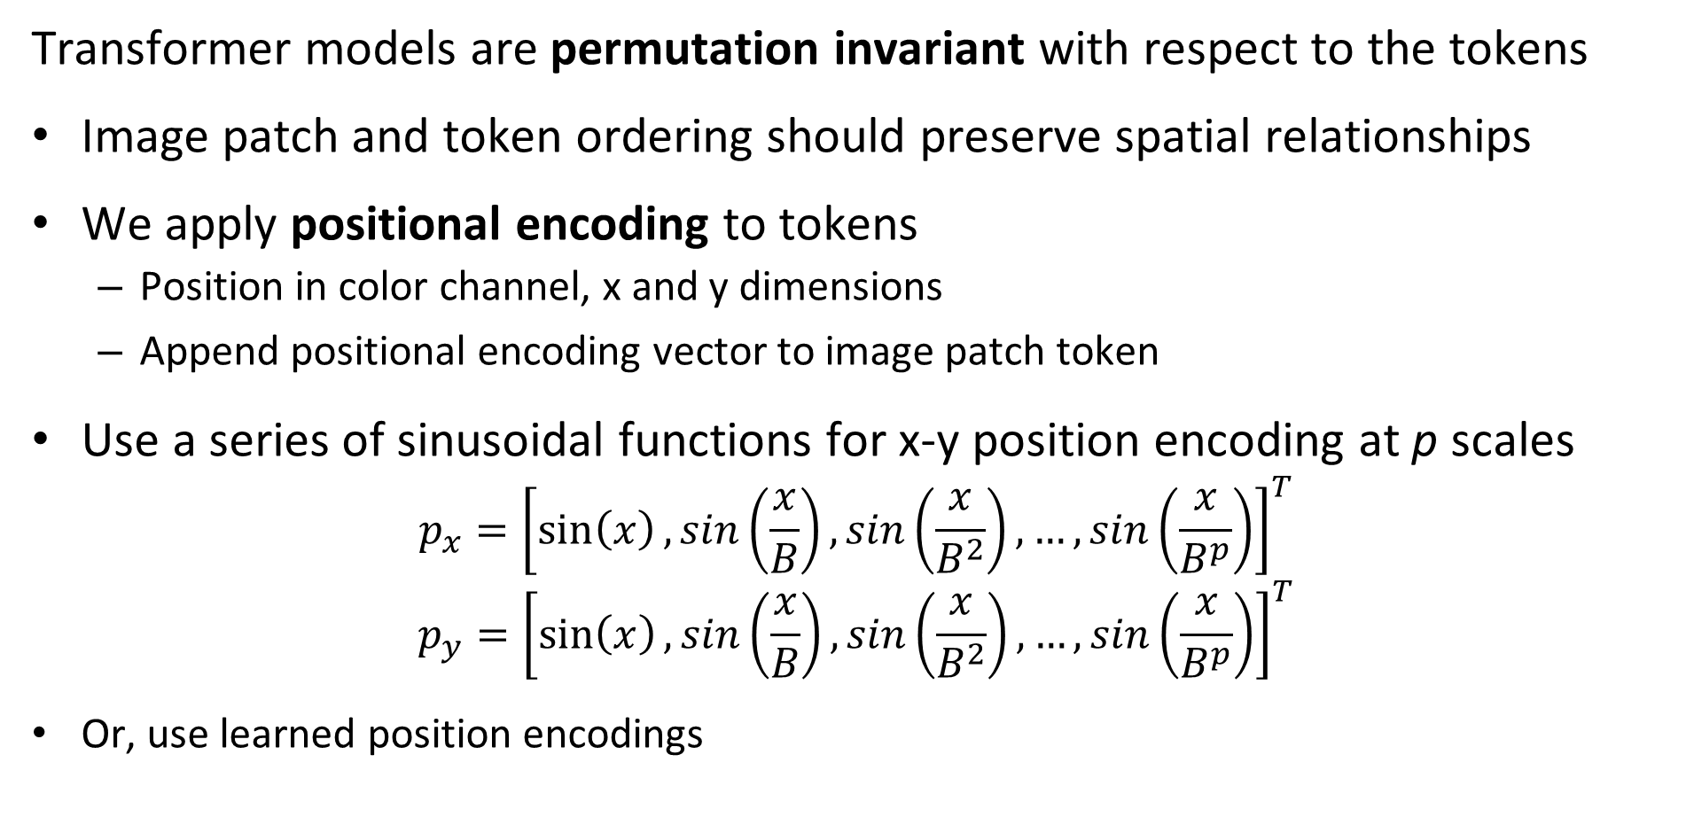
Why Do We Need Positional Encoding?
Transformer models are permutation invariant with respect to the tokens
Image patch and token ordering should preserve spatial relationships
We apply positional encoding to tokens
Position in color channel, x and y dimensions
Append positional encoding vector to image patch token
Use a series of sinusoidal functions for x-y position encoding at p scales
$$p_{x}={\left[\sin\left(x\right),sin\left(\frac{x}{B}\right),sin\left(\frac{x}{B^{2}}\right),…,sin\left(\frac{x}{B^{p}}\right)\right]}^{T}$$
$$p_{y}={\left[\sin\left(x\right),sin\left(\frac{x}{B}\right),sin\left(\frac{x}{B^{2}}\right),…,sin\left(\frac{x}{B^{p}}\right)\right]}^{T}$$
Or, use learned position encodings

Slide 27
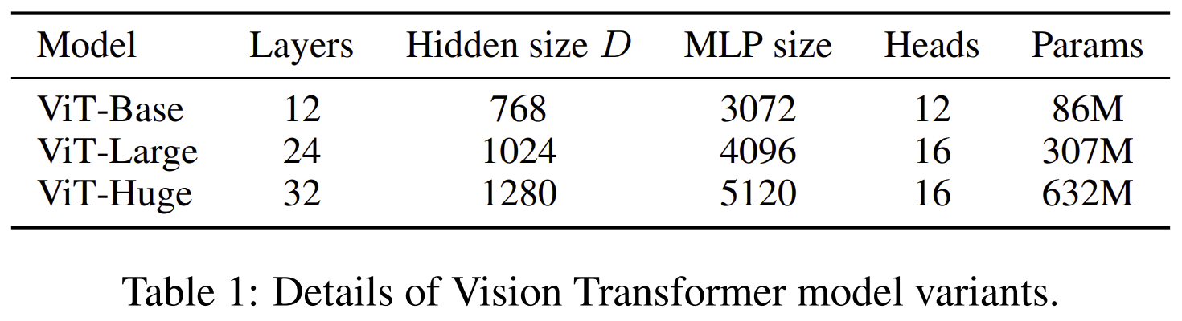
Family of ViT Architectures
Can trade-off model complexity for accuracy with ViT model
From Dosoviskiy, et.al., 2021

Slide 28
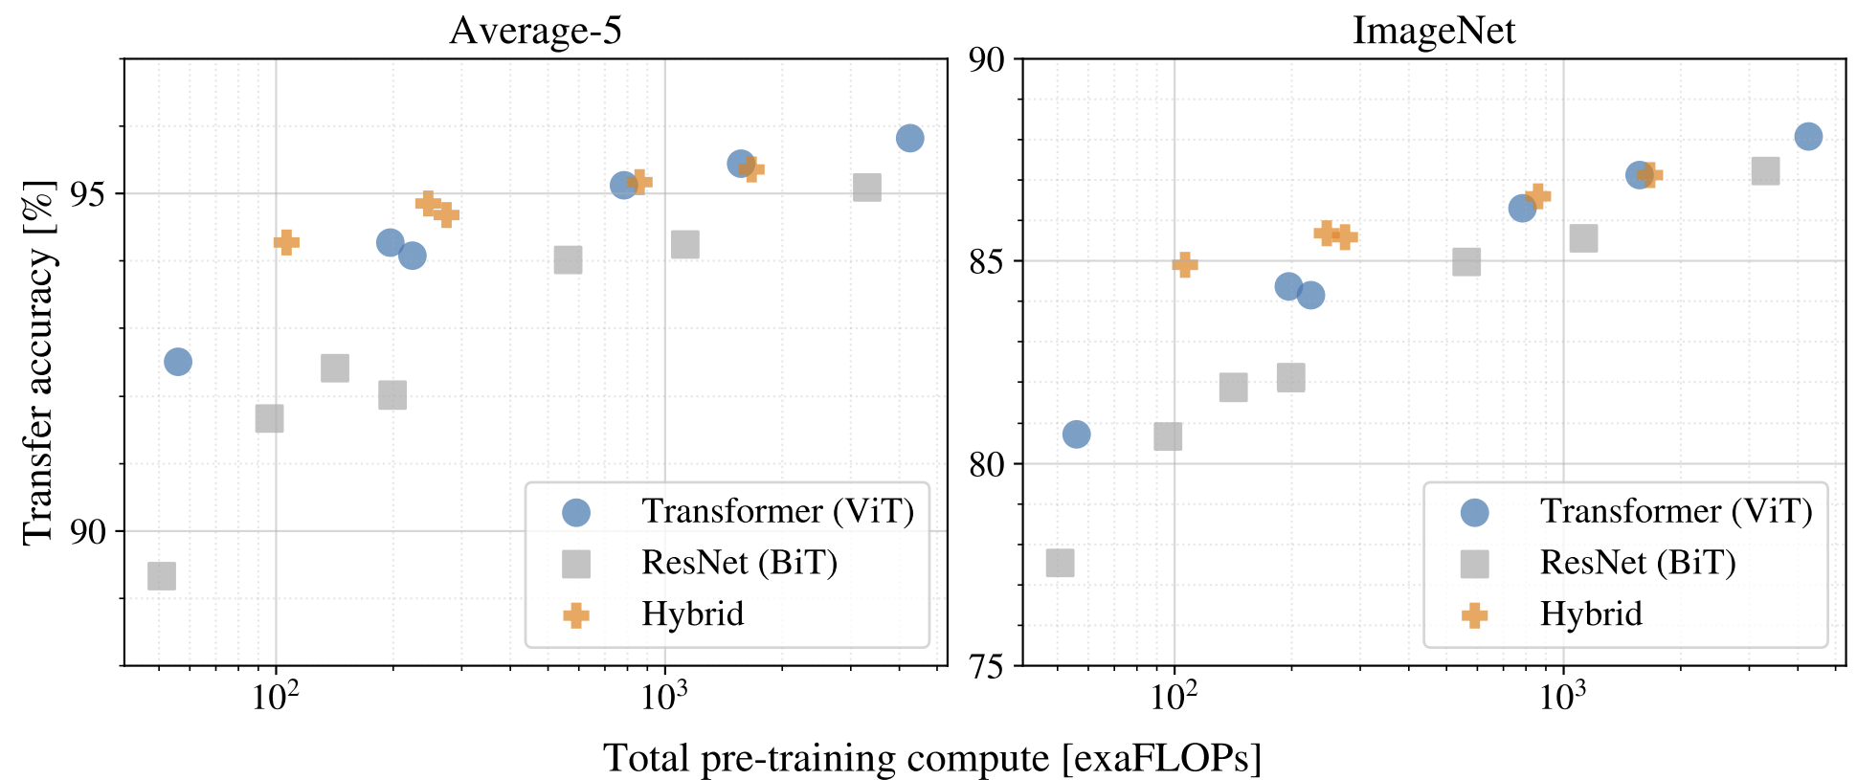
How Does the ViT Performance Compare?
From Dosoviskiy, et.al., 2021
Trade-off od complexity and accuracy comparable to CNN models

Slide 29
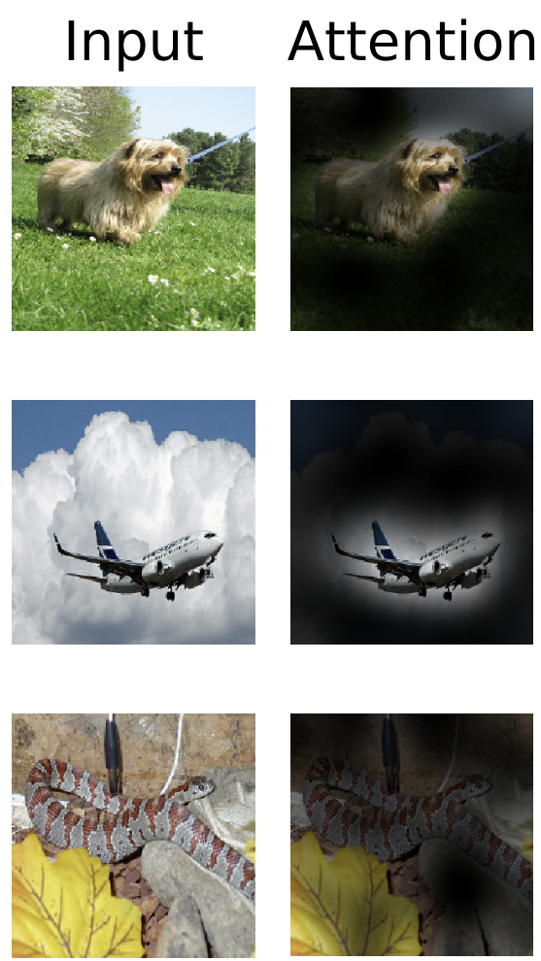
Attention Activations
What do the activations of the ViT model look like?
Compare input image to attention
Attention high for regions with objects of interest
From Dosoviskiy, et.al., 2021

Slide 30
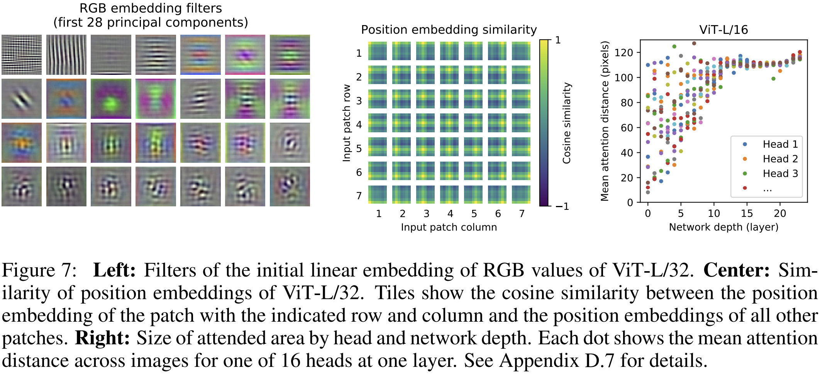
Attention Characteristics
What are the characteristics of the embedding and attention?
PCA of embedding and distance in attended area
From Dosoviskiy, et.al., 2021

Slide 31
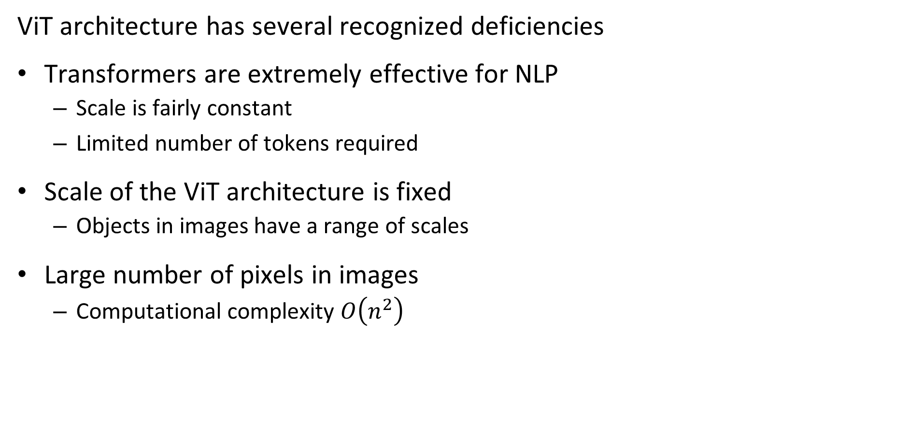
Deficiencies of ViT Architecture
ViT architecture has several recognized deficiencies
Transformers are extremely effective for NLP
Scale is fairly constant
Limited number of tokens required
Scale of the ViT architecture is fixed
Objects in images have a range of scales
Large number of pixels in images
Computational complexity $O\left(n^{2}\right)$

Slide 32
Self-Supervised Learning for CV

Slide 33
How Do We Train a CV Transformer Model?
Transformer models require massive training dataset
Transformer models have very large number of parameters
Sufficient labeled dataset are not available
Use self-supervised learning to pre-train models
Learn from tasks that do not require labels
Self-supervised learning routinely applied to SoA CNN models!

Slide 34
How Do We Train a CV Transformer Model?
Learn inherent features from pretext tasks that do not require labels
Self-supervised pretext tasks used to learn from inherent properties of images
Goal: learn representations invariant to transformations
Backbone network learns feature map for original and transformed images
Minimize Loss function between target and tranrformed images

Slide 35
How Do We Train a CV Transformer Model?
Learn inherent features from pretext tasks that do not require labels
Generative tasks learn feature map by creating new images
Conditionally generate image from learned latent space (feature map) with minimal difference to original image
Discriminative tasks learn to discriminate between same and different images
Learn feature map that minimizes difference between original and transformed image
Contrastive self-supervised learning learns features by minimizing contrast loss
Contrastive loss measured between original image and transformed image

Slide 36
Self-Supervised Learning
Generative tasks learn feature map by creating new images
Encoder learns a feature set
Keep encoder as pre-trained backbone for other tasks
Add new task-specific head and task-specific training
Decoder generates images
Uses learned features from encoder
Discard decoder after pretext training
Loss function is difference between target and generated image

Slide 37
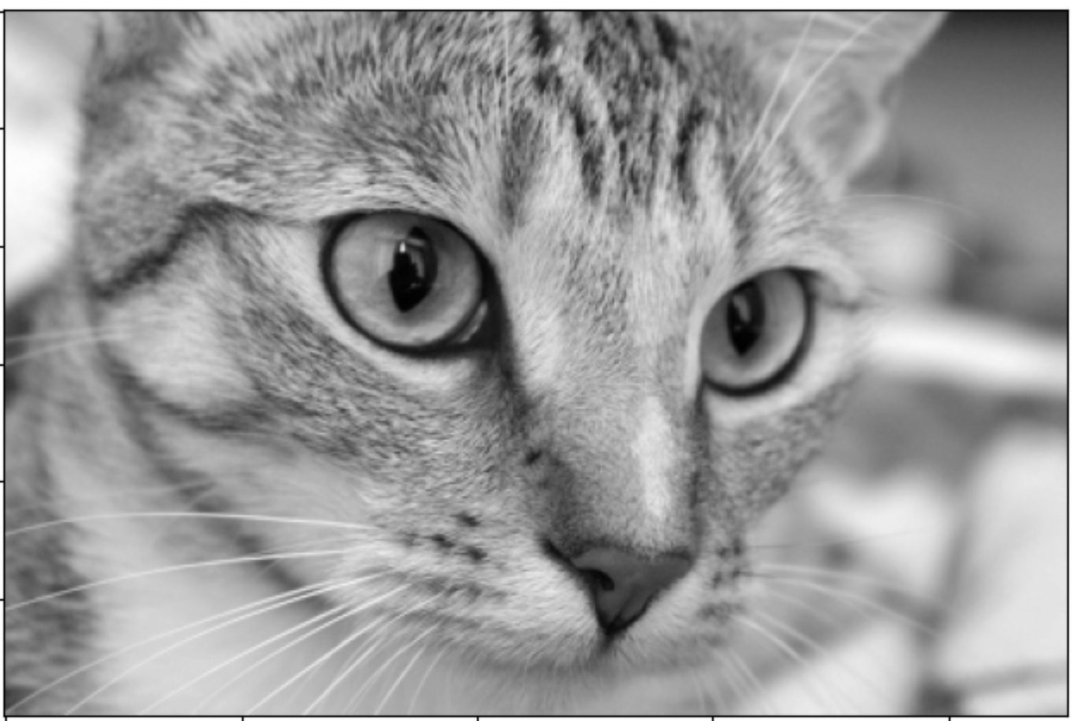
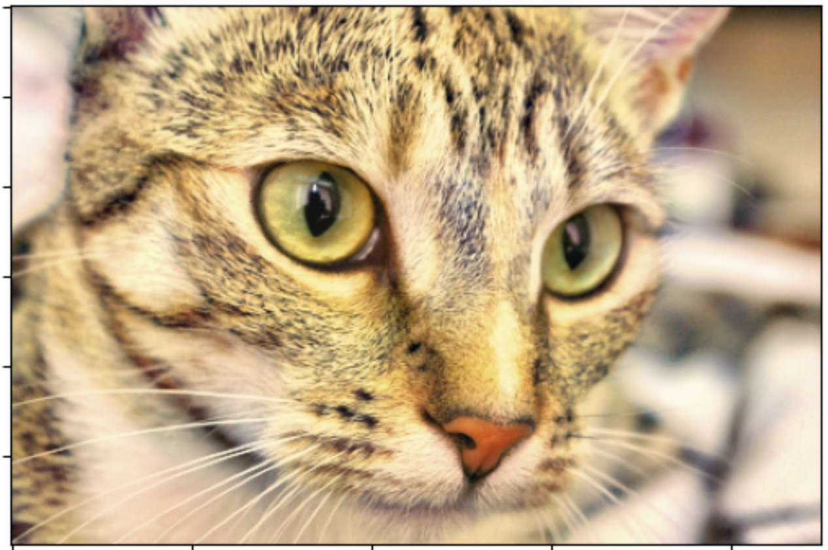
Self-Supervised Learning
Generative task example: color a gray-scale image
Original Image
1. Convert to gray-scale
4. Compute Loss
2. Encoder
Learns feature map
Pre-trained model
3. Decoder
Learns to generate image from feature map

Slide 38
Self-Supervised Learning
Discriminative tasks learn to discriminate between same and different images
Discriminative tasks employ an encoder backbone and a task specific decoder head
Backbone encoder learns a feature set
Keep encoder as pre-trained backbone for other tasks
Add new task-specific head and task-specific traning
Specific unsupervised pretext task performed by decoder head
Uses learned features from backbone to perform task
Discard decoder after pretext training
Loss function is based on discrimination accuracy

Slide 39
Self-Supervised Learning
Discriminative task example: recognize and reassemble image from random tiles
Original Image
1. Random Tile Image
4. Compute Loss
2. Backbone
Learns feature map
Pre-trained model
3. Head
Learns task using feature map

Slide 40
Contrastive Self-Supervised Learning
Contrastive self-supervised learning learns features by minimizing contrast loss
Discriminative tasks employ a backbone and a pretext task specific head
Backbone learns a feature set
Keep encoder as pre-trained backbone for other tasks
Add new task-specific head and task-specific training
Specific unsupervised pretext task performed by head
Uses learned features from backbone to perform pretext task
Discard decoder after pretext training
Loss function is based on discrimination accuracy

Slide 41
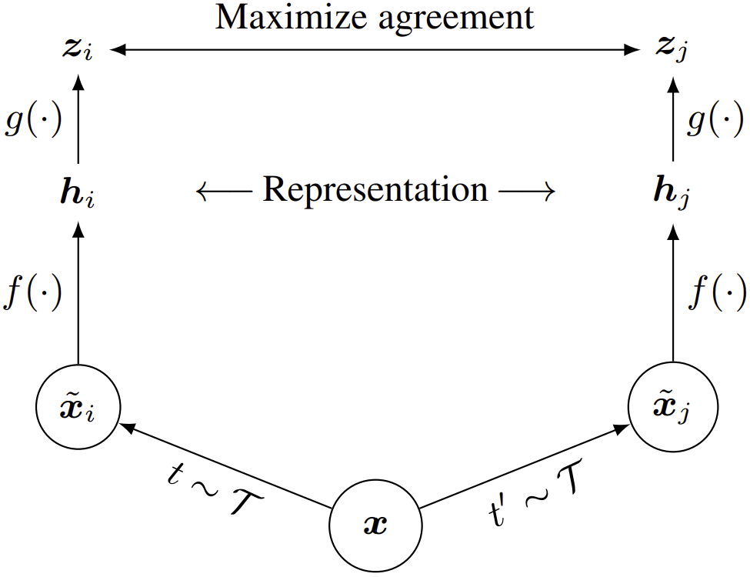
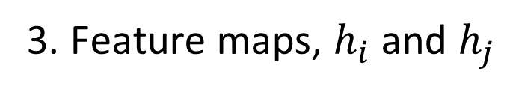
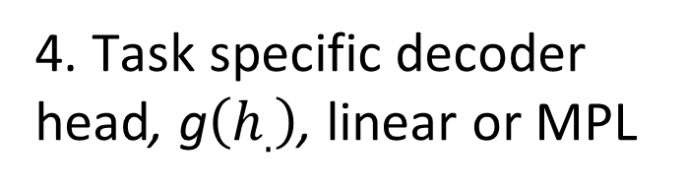
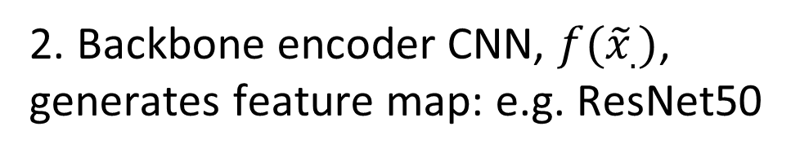
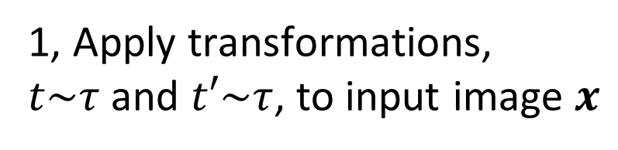
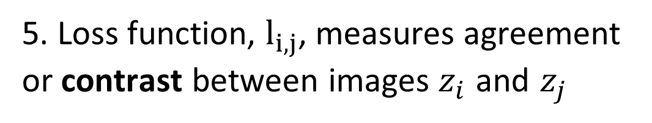
Contrastive Self-Supervised Learning
Contrastive self-supervised learning learns features by minimizing contrast loss
5. Loss function, $l_{i,j}$, measures agreement or contrast between images $z_{i}$ and $z_{j}$
4. Task specific decoder head, g$\left(h_{.}\right)$, linear or MPL
3. Feature maps, $h_{i}$ and $h_{j}$
2. Backbone encoder CNN, $f({\tilde{x}}_{.})$, generates feature map: e.g. ResNet50
1, Apply transformations,
$t\sim τ$ and $t′\sim τ$, to input image $x$
From Chen, et.al., 2020

Slide 42
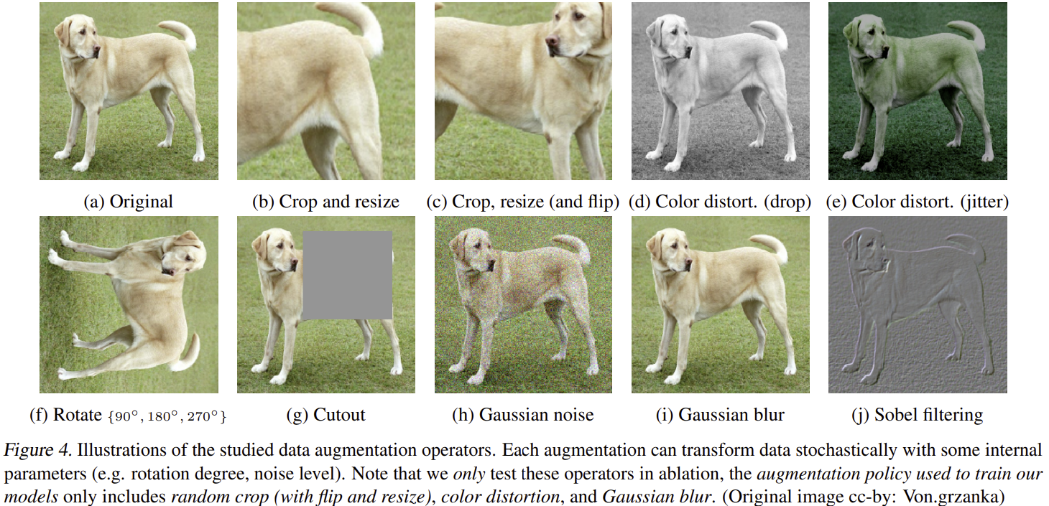
Contrastive Self-Supervised Learning
Examples of image transformations for contrastive self-supervised learning
From Chen, et.al., 2020

Slide 43
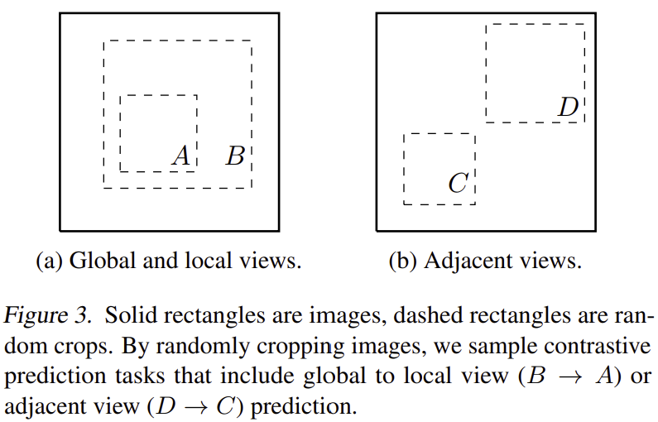
Contrastive Self-Supervised Learning
Examples possible image crops
A few of an infinite number of possibilities
From Chen, et.al., 2020

Slide 44
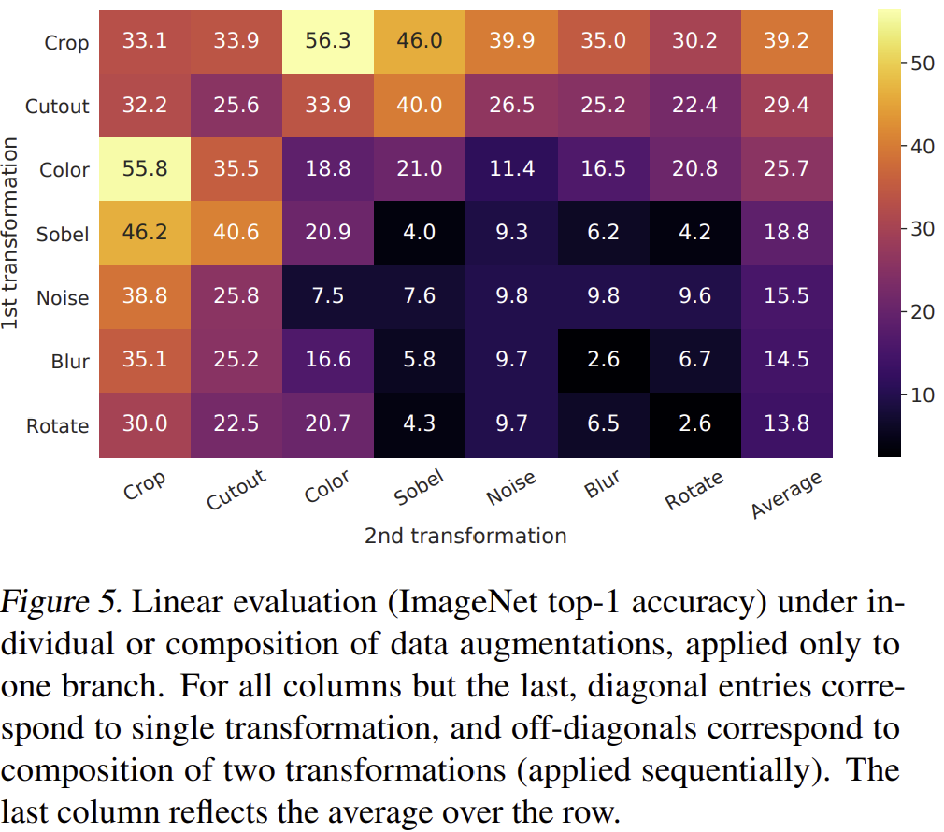
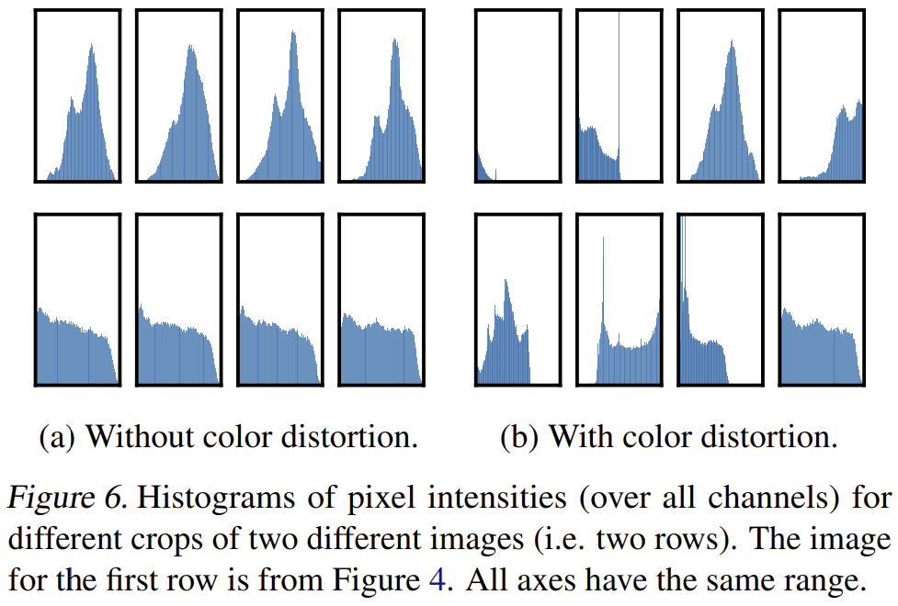
Contrastive Self-Supervised Learning
How do some of the possible transformations behave?
Interactions between transformations
Importance of color distortion
From Chen, et.al., 2020

Slide 45
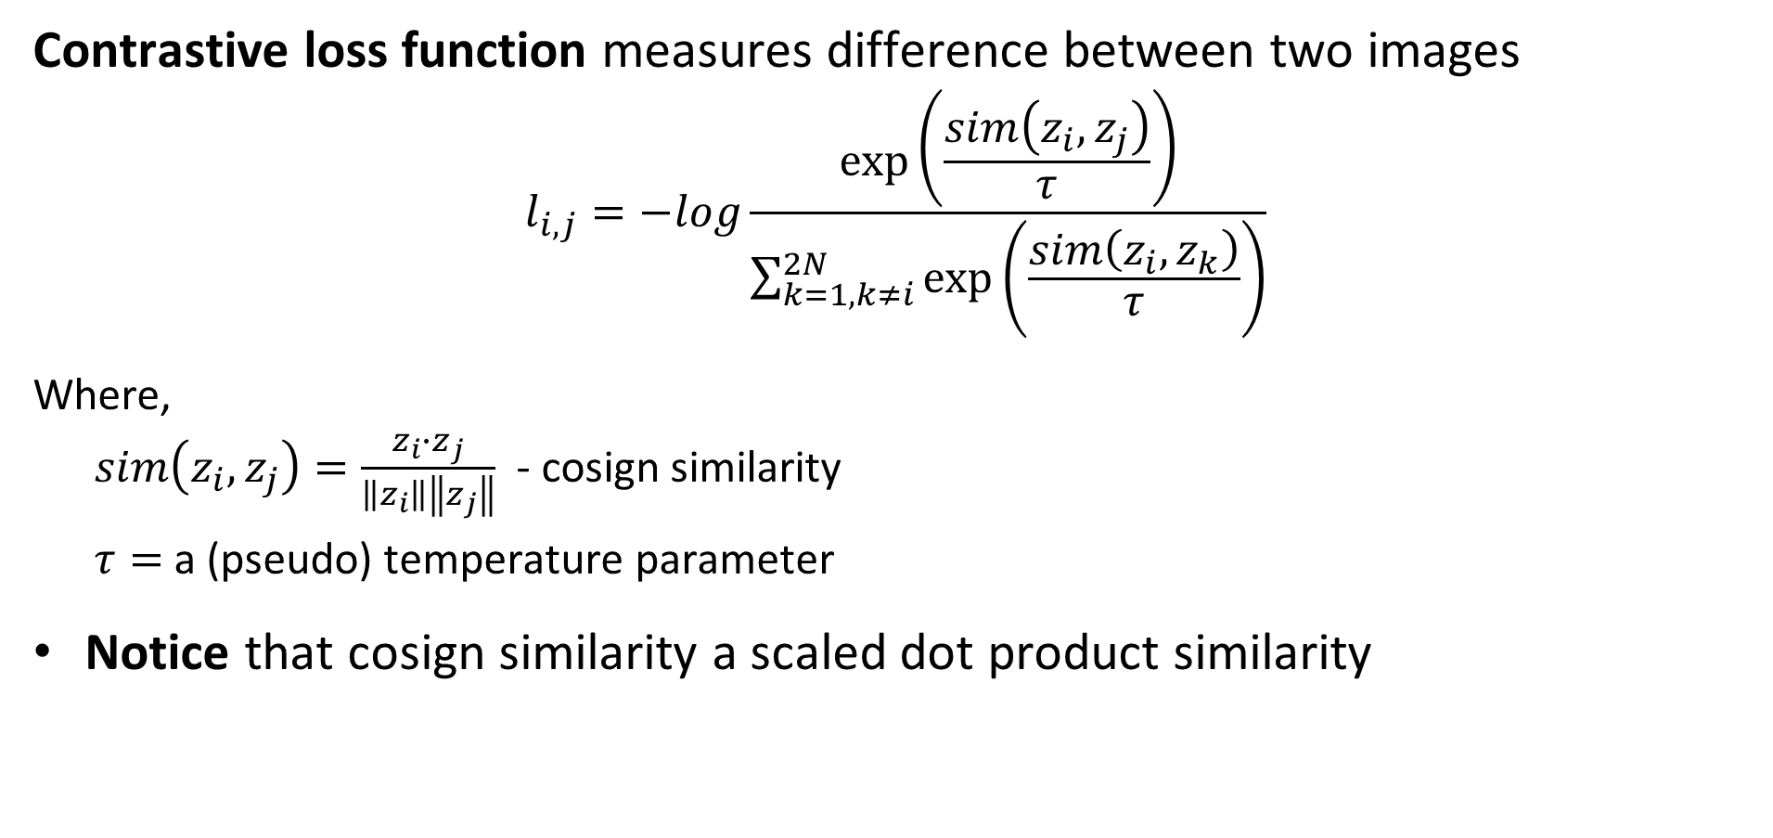
Contrastive Self-Supervised Learning
Contrastive loss function measures difference between two images
$$l_{i,j}=−log\frac{\exp\left(\frac{sim\left(z_{i},z_{j}\right)}{τ}\right)}{\sum_{k=1,k≠i}^{2N}{\exp\left(\frac{sim\left(z_{i},z_{k}\right)}{τ}\right)}}$$
Where,
$sim\left(z_{i},z_{j}\right)=\frac{z_{i}∙z_{j}}{\left\|z_{i}\right\|\left\|z_{j}\right\|}$ - cosign similarity
$τ=$ a (pseudo) temperature parameter
Notice that cosign similarity a scaled dot product similarity

Slide 46
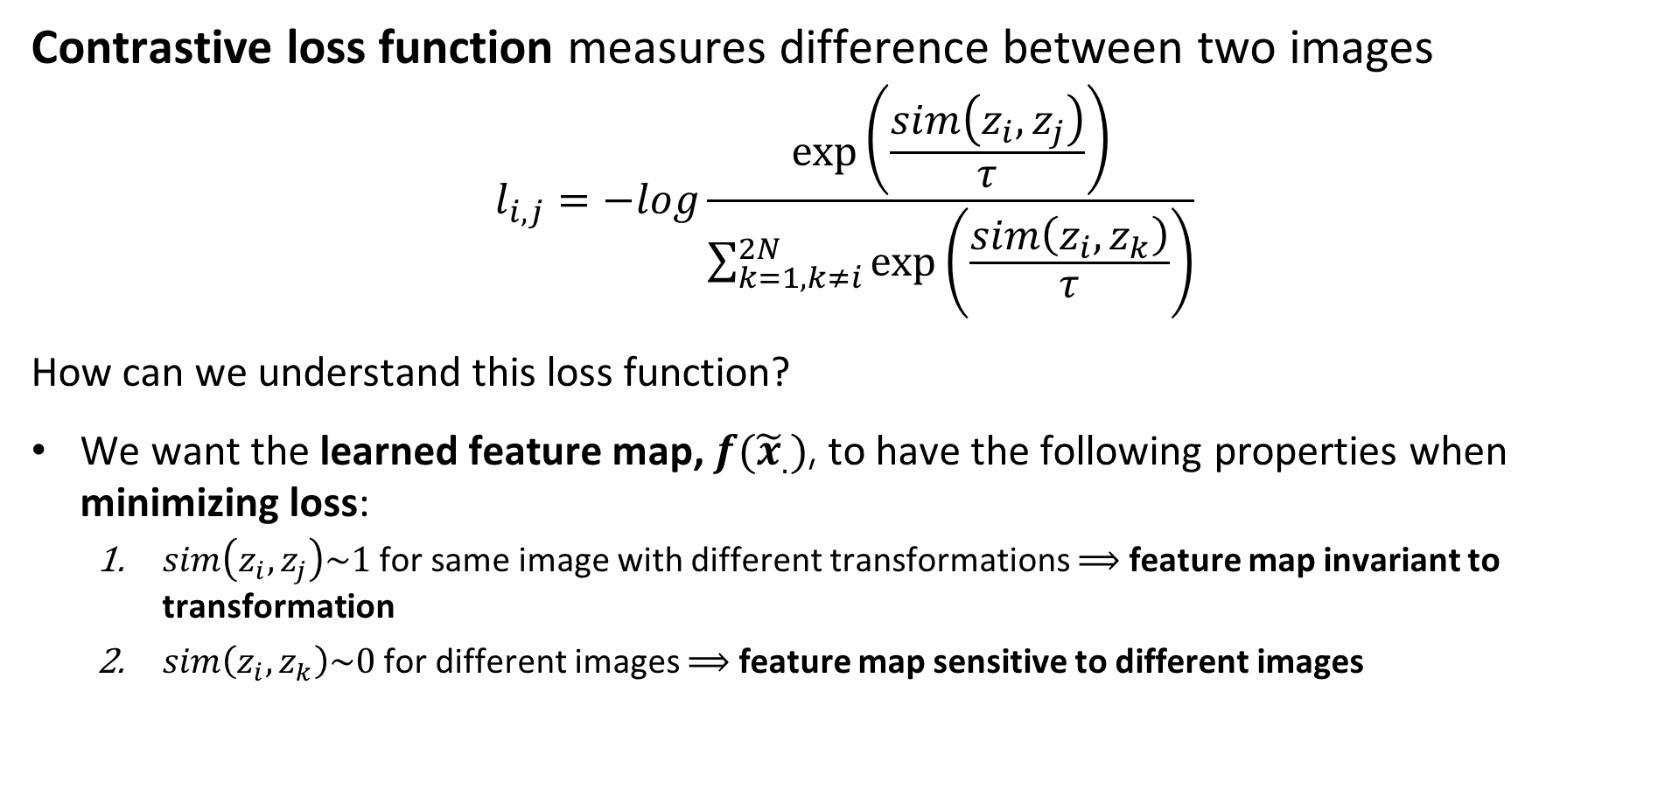
Contrastive Self-Supervised Learning
Contrastive loss function measures difference between two images
$$l_{i,j}=−log\frac{\exp\left(\frac{sim\left(z_{i},z_{j}\right)}{τ}\right)}{\sum_{k=1,k≠i}^{2N}{\exp\left(\frac{sim\left(z_{i},z_{k}\right)}{τ}\right)}}$$
How can we understand this loss function?
We want the learned feature map, $f({\tilde{x}}_{.})$, to have the following properties when minimizing loss:
$sim\left(z_{i},z_{j}\right)\sim 1$ for same image with different transformations $⟹$ feature map invariant to transformation
$sim\left(z_{i},z_{k}\right)\sim 0$ for different images $⟹$ feature map sensitive to different images

Slide 47
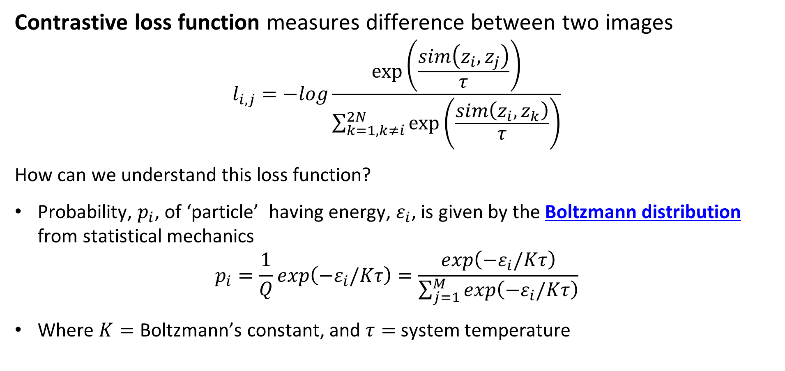
Contrastive Self-Supervised Learning
Contrastive loss function measures difference between two images
$$l_{i,j}=−log\frac{\exp\left(\frac{sim\left(z_{i},z_{j}\right)}{τ}\right)}{\sum_{k=1,k≠i}^{2N}{\exp\left(\frac{sim\left(z_{i},z_{k}\right)}{τ}\right)}}$$
How can we understand this loss function?
Probability, $p_{i}$, of ‘particle’ having energy, $ε_{i}$, is given by the Boltzmann distribution from statistical mechanics
$$p_{i}=\frac{1}{Q}exp\left(−ε_{i}/Kτ\right)=\frac{exp\left(−ε_{i}/Kτ\right)}{\sum_{j=1}^{M}{exp\left(−ε_{i}/Kτ\right)}}$$
Where $K=$ Boltzmann’s constant, and $τ=$ system temperature

Slide 48
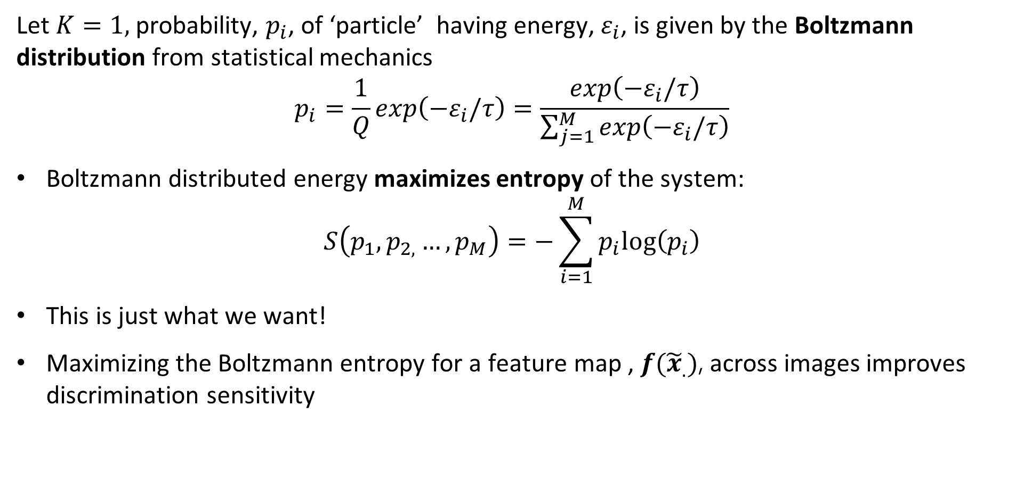
Contrastive Self-Supervised Learning
Let $K=1,$ probability, $p_{i}$, of ‘particle’ having energy, $ε_{i}$, is given by the Boltzmann distribution from statistical mechanics
$$p_{i}=\frac{1}{Q}exp\left(−ε_{i}/τ\right)=\frac{exp\left(−ε_{i}/τ\right)}{\sum_{j=1}^{M}{exp\left(−ε_{i}/τ\right)}}$$
Boltzmann distributed energy maximizes entropy of the system:
$$S\left(p_{1},p_{2,}…,p_{M}\right)=−\sum_{i=1}^{M}{p_{i}log⁡\left(p_{i}\right)}$$
This is just what we want!
Maximizing the Boltzmann entropy for a feature map , $f({\tilde{x}}_{.})$, across images improves discrimination sensitivity

Slide 49
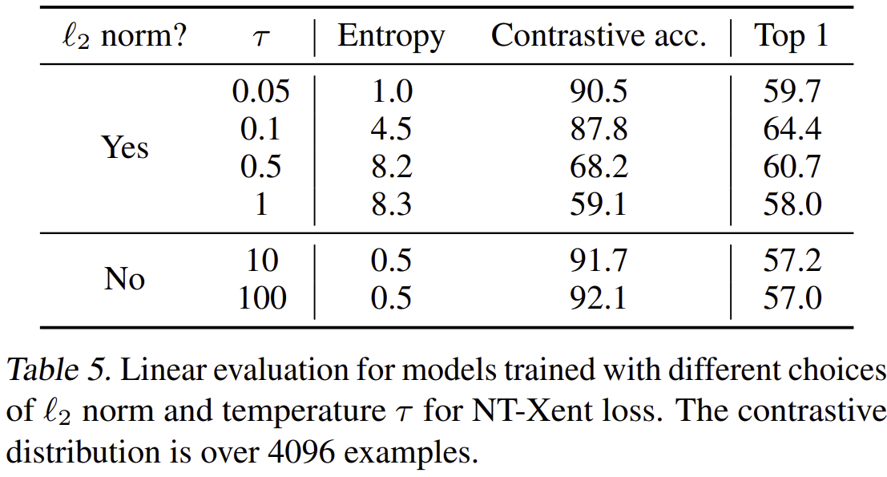
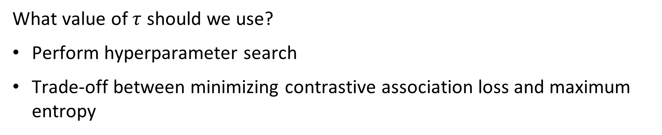
Contrastive Self-Supervised Learning
What value of $τ$ should we use?
Perform hyperparameter search
Trade-off between minimizing contrastive association loss and maximum entropy
From Chen, et.al., 2020

Slide 50

Contrastive Self-Supervised Learning
How well does contrastive pretext learning work?
From Chen, et.al., 2020

Slide 51
Scaling Vision Transformers

Slide 52


Scaling Vision Transformers
Zhai, et.al, 2022, investigated the relationship of model and training set size
Larger models and larger data sets $⇒$ lower error rate
But, all models show saturation

Slide 53
Scaling Vision Transformers
Zhai, et.al, 2022, investigated the relationship of model and training set size
Combination of larger model and training data required for optimal performance
Representation quality constrained by model size
Training dataset size beyond 1-3B images will improve massive models!

Slide 54

Scaling Vision Transformers
Zhai, et.al, 2022, investigated the relationship of model and training set size
Improved performance is achieved with massive training dataset and many fine-tuning epochs

Slide 55

Scaling Vision Transformers
Zhai, et.al, 2022, investigated the relationship of model and training set size
Using independent learning rates for head (top) and backbone improved performance

Slide 56
What Do Transformers See?

Slide 57

What Do Transformers See
Rahgu, et.al, 2022, investigated the feature maps of ResNets and Transformer
Vision transformer activations show great similarity between lower and higher layers
Whereas, ResNets show greater similarity between neighboring layers

Slide 58

What Do Transformers See
Rahgu, et.al, 2022, investigated the feature maps of ResNets and Transformer
Lower attention heads have great range of attention distance from local to global
Deeper attention heads have long range attention distance, focusing on scene semantics

Slide 59

What Do Transformers See
Rahgu, et.al, 2022, investigated the feature maps of ResNets and Transformer
Vision transformer activations remain local for localized input
Whereas, ResNets activations become diffuse with depth

Slide 60
Hybrid CNN +Transformer Models Making Transformers Efficient 2

Slide 61

EfficientFormer V2
EfficientFormer V2 optimizes accuracy performance and maintains efficiency using hybrid CNN-transformer architecture
Optimize performance across 3 dimensions
Complexity and model parameters
Inference time and throughput
Accuracy
Key updates for SWIN shifting windows hard to manage on mobile devices
From Li, et.al., 2023

Slide 62




EfficientFormer V2
EfficientFormer improves on previous hybrid transformer architectures
Token mixer layers replaced with feed forward network (FFN) (MLP) layers with pure CNNs
Mixing layer uses $1×1$ CONV layers for up-down sampling
GeLU activation maintained
Single residual loop
From Li, et.al., 2023

Slide 63


EfficientFormer V2
Gaussian error linear units, GeLU, activation
GeLU is a nonlinear activation based on Gaussian error function
$$GeLU\left(x\right)=x P\left(X≤x\right)$$
GeLU has smooth transition at 0
No vanishing gradient around 0
From Papers With Code

Slide 64


EfficientFormer V2
EfficientFormer improves on previous hybrid transformer architectures
From Li, et.al., 2023
Modified MHSA block boosts performance by 0.3% with no increase in complexity or latency
$3×3$ DW CONV adds local information to values, V
MLP add communications between heads, a.k.a. talking heads

Slide 65


EfficientFormer V2
EfficientFormer improves on previous hybrid transformer architectures
4-Layer model found to provide optimal trade-off of complexity, latency, and accuracy
Layer scales of $\frac{1}{4},\frac{1}{8},\frac{1}{16},\frac{1}{32}$
2 local FFN layers provide inductive bias from CNN
2 local-global attention layers
From Li, et.al., 2023

Slide 66


EfficientFormer V2
EfficientFormer improves on previous hybrid transformer architectures
First local-global attention layer uses fairly standard architecture
Down sample fixed $\frac{1}{32}$ scale to reduce quadratic complexity
Mix channels/heads
Compute stride dot product attention
Up sample to $\frac{1}{16}$ scale
From Li, et.al., 2023

Slide 67


EfficientFormer V2
EfficientFormer improves on previous hybrid transformer architectures
Second local-global modified attention layer
Mix channels/heads
Dual-path down sample uses max pooling and DWCONV past to reduce query, , by half
${Out}_{[B,H,\frac{N}{2},c]}=\left(Q_{[B,H,\frac{N}{2},c]}∙{K^{T}}_{[B,H, c,N]}\right)∙V_{[B,H, c,N]}$
CONV layer in residual loop
Compute self attention
Mix channels/heads
From Li, et.al., 2023

Slide 68

EfficientFormer V2
The architectural details of EfficientFormer V2 are optimized through a series of ablation studies
At each step the accuracy, latency and complexity are evaluated
From Li, et.al., 2023

Slide 69
Summary
Vision transformers are seen as an alternative to CNNs
Vision transformers build globally sensitive feature maps
Vision transformers (ViTs) comprise several components
Sequence of image patches
Multi-headed self-attention
Self-supervised training on massive datasets
Vision transformers are computationally complex for training and inference
Generally, state-of-the-art ViT performance requires greater computation compared to CNN architectures

Slide 70
Summary
Vision transformers are seen as an alternative to CNNs
Contrastive self-supervised learning for transformation-invariant pre-training
Sharpness-aware minimization (SAM) improves ViT training and generalization
Error rate declines with combination of larger (complex) model and larger training dataset

Slide 71
Shifting Window (SWIN) Transformer Making Transformers Efficient 1

Slide 72
Toward Efficient Transformer Models
Efficient deep neural network architectures trade-off three performance metrics
Complexity and model parameters: more complex models have higher capacity but harder to train, need larger datasets
Error rate for task: measure of model effectiveness for task
Throughput: how fast can the NN perform inference, inverse of inference time
Complexity and model parameters
Throughput
Error rate for task

Slide 73
SWIN Transformer
Shifted Window (SWIN) transformer introduces more efferent transformer architecture
ViT architectures have quadratic complexity with increasing resolution
High inference time
Limited resolution limits possible tasks
Successful with classification, uses low resolution
Poor fit to tasks requiring high resolution, e.g. segmentation
SWIN architecture using shifting windows to reduce complexity

Slide 74

SWIN Transformer
Shifted Window (SWIN) transformer introduces architecture for features at multiple scales
SWIN Transformer uses hierarchy of scales
SWIN Transformer employs overlapping sliding windows to accommodate different scales
From Lui, et.al., 2021

Slide 75

SWIN Transformer
Shifted Window (SWIN) transformer introduces architecture for features at multiple scales
SWIN Transformer employs overlapping windows to accommodate different scales
Shifting windows may improve global attention
The shifting method reduces computation
From Lui, et.al., 2021

Slide 76

SWIN Transformer
Why is the SWIN Transformer efficient?
Computational complexity of the ViT architecture using $M×M$ patches, with a complexity parameter $C$, is quadratic in patch size, $h×w$:
$$Ω\left(MSA\right)=4hwC^{2}+2{\left(hw\right)}^{2}C$$
Computation complexity of SWIN transformer is linear in patch size , $h×w$ for $M×M$ windows:
$$Ω\left(MSA\right)=4hwC^{2}+2M^{2}hwC$$
SWIN transformer is linear in patch size, $h×w$!

Slide 77

SWIN Transformer
Shifted Window (SWIN) transformer uses cyclic shift for efficiency
SWIN uses efficient cyclic shifts generated with key update
Masking prevents leakage across non-adjacent tokens (patches)

Slide 78

SWIN Transformer
Shifted Window (SWIN) transformer uses different attention block
SWIN Transformer block uses Window-Multi-Headed Self-Attention (W-MSA)
Uses linear activation
Shifted window MSA, SW-MSA, updates from shifted window mask, from key update
See paper for details
From Lui, et.al., 2021

Slide 79


SWIN Transformer
SWIN architecture employs patch merging to achieve multi-scale attention
Linear embedding transforms $4×4×3=48$ pixel values per patch to C values
Linearly scales by dividing patches and multiplying C by 2
Patch resolutions $\frac{1}{4},\frac{1}{8},\frac{1}{16},\frac{1}{32}$
From Lui, et.al., 2021

Slide 80

SWIN Transformer
SWIN achieves near state-of-the-art performance
From Lui, et.al., 2021

Slide 81
Optimization For Vision Transformers

Slide 82
Optimization for Transformers
Vision Transformers have proved difficult to train and generalize
CNNs have proved easy to train
Inductive biases work in CNNs favor
Localization
Translation invariance
ViTs trained on massive data sets using augmentation and self-supervised learning
ViT generalization can be poor.
What can be done to improve ViT training?

Slide 83

Optimization for Transformers
Vision Transformers have proved difficult to train and generalize
Chen, et.al., 2022, investigate this problem
Compare cross entropy loss surface of ResNet 152 and ViT B/16
Gradients loss function for ViT are localized and extreme compared to ResNet!
Localized and extreme gradients explain difficult training and poor generalization

Slide 84
Optimization for Transformers
Vision Transformers have proved difficult to train and generalize
What can be done to improve ViT training?
Chen, et.al., 2022 proposed using sharpness-aware minimizer (SAM) proposed by Forest, et.al., 2021
Now implemented as Sharpness-Aware-Minimization-TensorFlow
SGD optimizers only minimize gradient
SGD optimizers incorporate no smoothness constraint into the loss function
Poor smoothness of loss function surface makes training and generalization difficult
Rough loss services change rapidly with small changes in data values

Slide 85

Optimization for Transformers
Sharpness-aware minimization (SAM)
SAM proposed by Forest, et.al., 2021 uses loss function with smoothness term
$$\min_{W}{\max_{\left\|ε\right\|≤ρ}{ℒ_{train}\left(W+ ℇ\right)}}$$
Loss is minimized over some neighborhood, $\left\|ε\right\|≤ρ$, rather than just locally
$$\hat{ε}\left(W\right)=\frac{ρ∇_{W}ℒ_{train}\left(W\right)}{\left\|∇_{W}ℒ_{train}\left(W\right)\right\|}$$
With neighborhood size hyperparameter $ρ$

Slide 86


Optimization for Transformers
Sharpness-aware minimization (SAM)
Using SAM smooths the ViT loss function
Eliminates extreme gradients
Larger ‘flat’ area around minimum improves generalization
From Chen, et.al., 2022

Slide 87

Optimization for Transformers
Sharpness-aware minimization (SAM)
SAM reduces the largest eigenvalue of the Hessian
Loss increases
Error rate decreases
From Chen, et.al., 2022

Slide 88

Optimization for Transformers
Sharpness-aware minimization (SAM)
Both SAM and data augmentation improve model performance
Combination of SAM and data augmentation is best
ResNet-152 gives better performance for smaller training dataset
From Chen, et.al., 2022

Slide 89


Optimization for Transformers
Sharpness-aware minimization (SAM)
SAM creates better defined global attention map
Smoother loss function $⇒$ less localized attention
From Chen, et.al., 2022

